Slide 1
The 6th annual Data Science Hackathon!
Presents
Sponsored By:
Two Sigma
NYC Data Science Academy

Slide 2
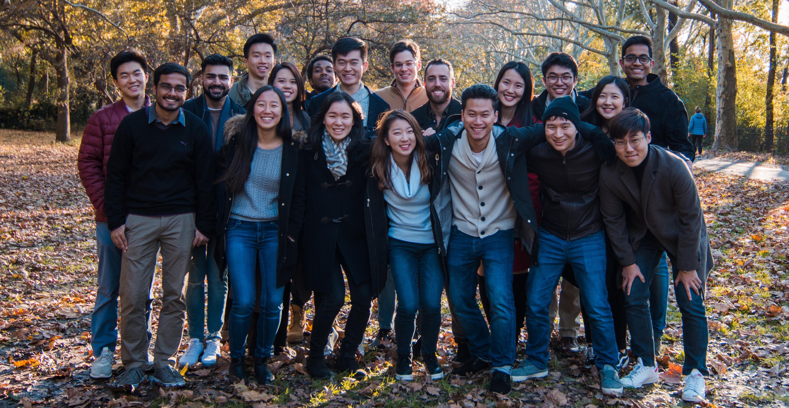
Who are we?
CDSS is an interdisciplinary society that promotes data science across Columbia University and the New York City community.
We are a team of undergraduate and graduate students from many majors and disciplines, and we work together to plan and host a variety of events including workshops, recruiting events, panels, discussions, as well as our annual hackathon!

Slide 3

Quick Plug…
We are now taking applications for new E-board members!
https://forms.gle/qii15Z37hckFTNip9

Slide 4
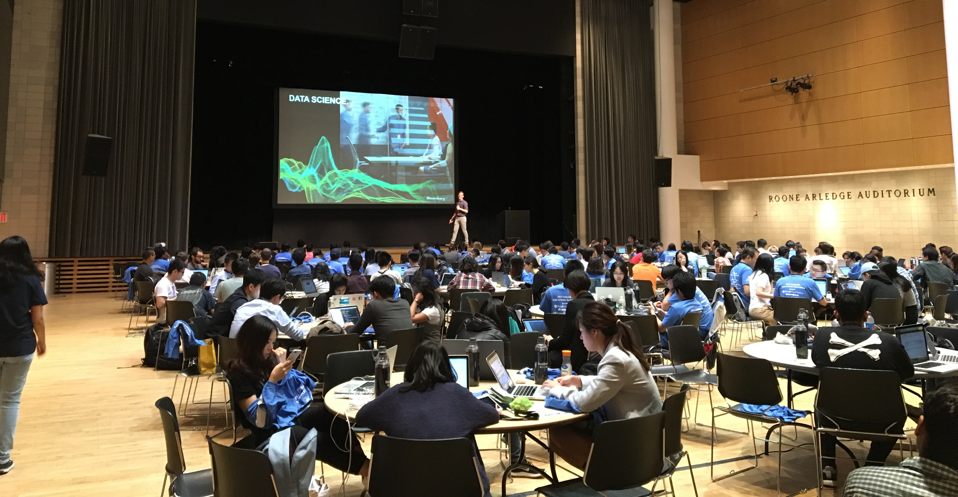
What is the Data Science Hackathon?
The Data Science Hackathon is CDSS’s largest annual event: a friendly competition that encourages students of all skill levels to work together an engage in a meaningful data-problem, honing their skills along the way.
We hope that by the end, you’ll not only have a new project under your belt, but you’ll also feel more confident in your ability to collaborate on data and communicate your findings, and you’ll have a refreshed appetite for more data science!

Slide 5
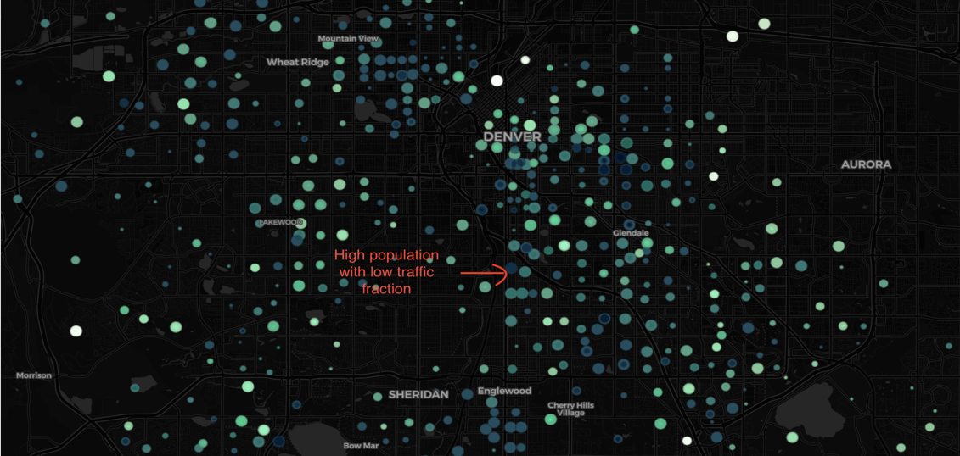
What is the Data Science Hackathon?
We select a dataset (or multiple datasets) that contains information that we could use to solve a problem. We want you and your team, through the computational methods at your disposal, to learn new insights from this dataset, and present that knowledge to us and a panel of judges.
Patterns in the data can take many forms, and often the most interesting patterns are relationships between variables. A presentation should evaluate these relationships, judge their strength, visualize them, and if possible, model them.

Slide 6
The Process
Frame the problem and look at the big picture
Get the data
Explore the data
Prepare the data
Short-list promising models
Fine-Tune the System
Summarize and Visualize your model
Present your solution
https://github.com/ageron/handson-ml/blob/master/ml-project-checklist.md

Slide 7
Recommendations
Divide and conquer the work
Don’t underestimate visualization during EDA
Scatter-matrices, residual plots, heatmaps, geo-plots, etc.
Setup a collaborative environment
Google Collab, Github
Set a deadline for starting presentation
Ask questions!
We can’t answer questions that assist you in your project, but we can answer general questions and logistics questions
Contact us during virtual office hours at cdss_executives@Columbia.edu

Slide 8
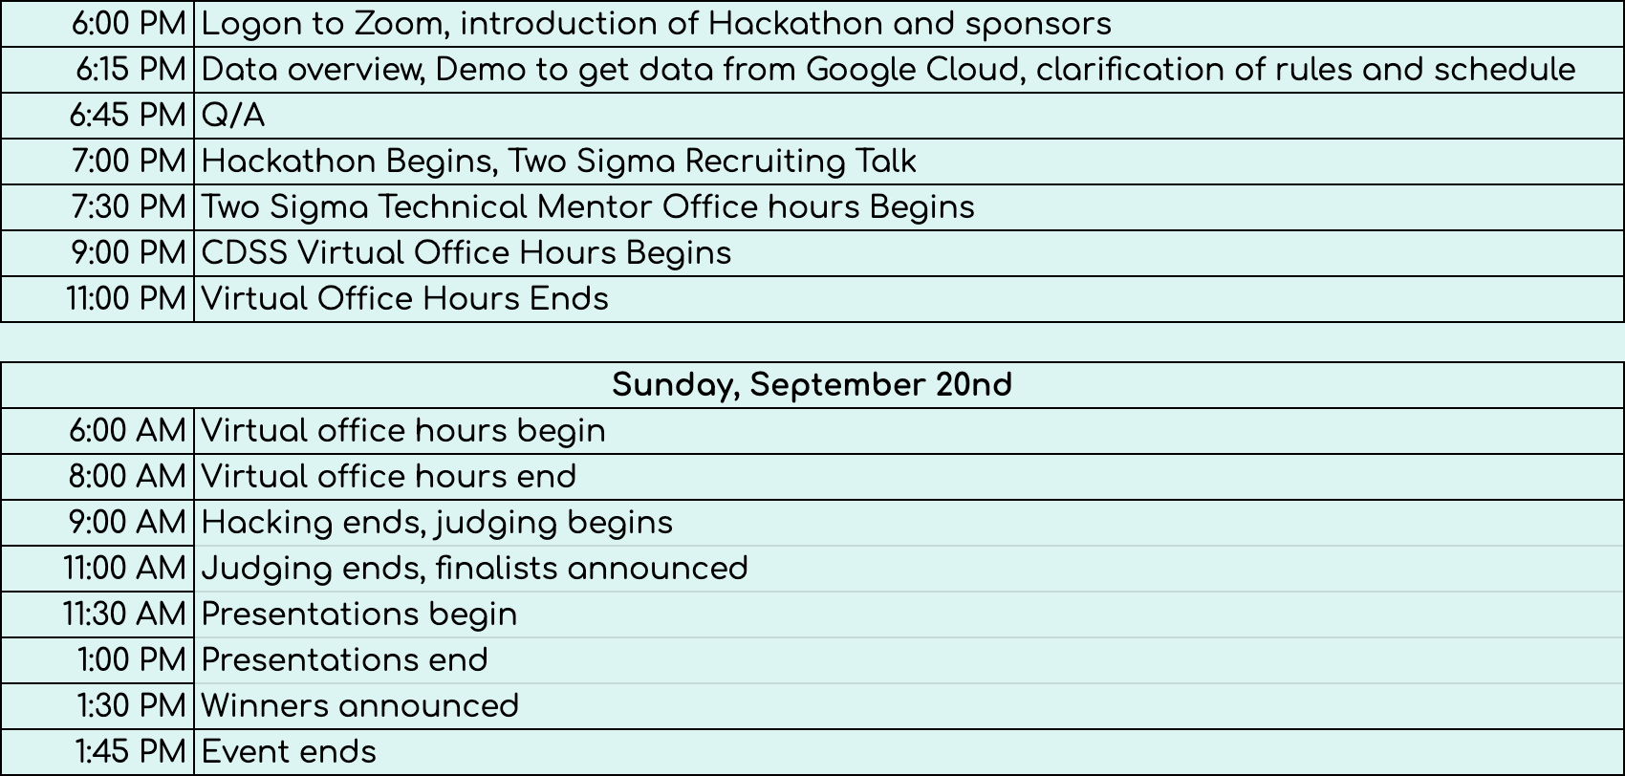
Schedule

Slide 9

How has COVID-19 affected mobility of people and goods across the globe?
And this year’s theme is…

Slide 10

Let’s take a look at the data…
https://console.cloud.google.com/marketplace/product/bigquery-public-datasets/covid19-public-data-program?project=cdss-hackathon-test&folder=&organizationId=

Slide 11
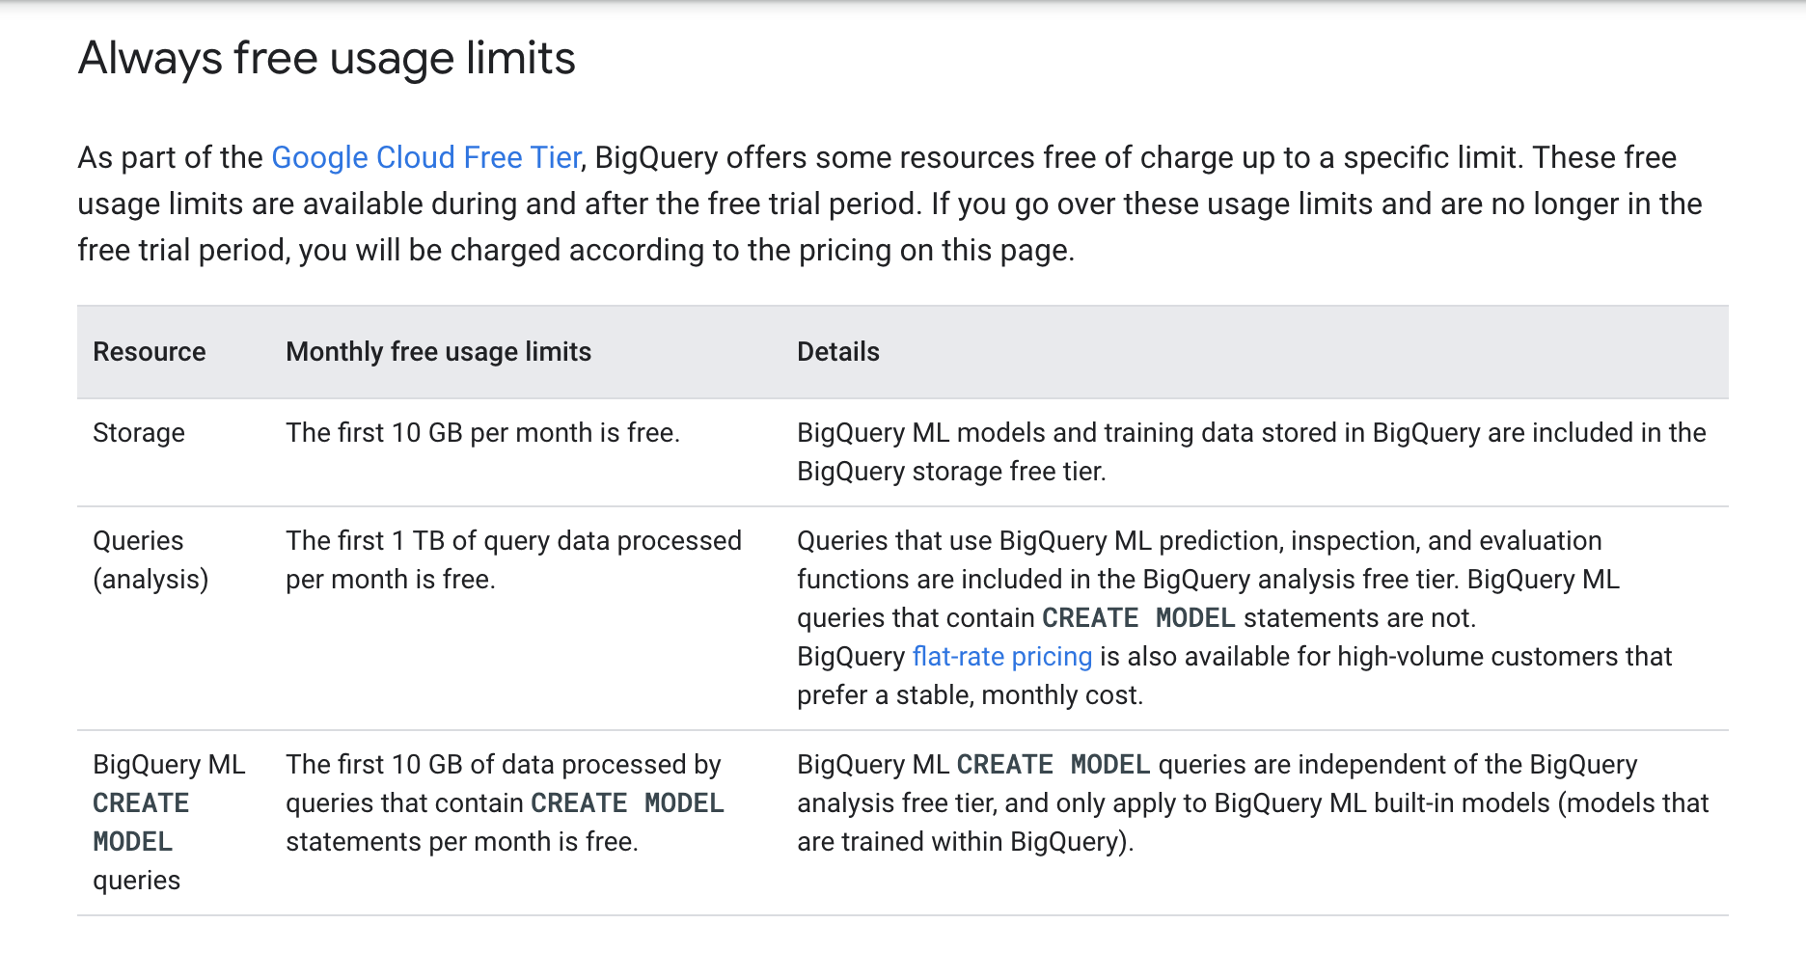
Data Usage

Slide 12
How to Submit
Submission must be a PowerPoint (preferably >2013)
Presentation should be no longer than 10 minutes
Must submit before 9:00 a.m. EST Sunday, September 20th
Email cdss_executives@columbia.edu
Include the names of all team members
Attach your powerpoint
Attach all relevant code
Confirm your availability to present if you are selected as a finalist
Include a team name (Optional)

Slide 13
And the winner is…
Finalists will present 11:30 a.m. – 1:00 p.m. EST
The top three teams will be eligible for cash prizes from our sponsor, Two Sigma
1st Place: $500
2nd Place: $350
3rd Place: $150
Winners will be announced at 1:30 p.m. EST

Slide 14
Stick Around
Two Sigma Recruiting Talk: 7:00 pm – 7:30 EST (same zoom)
Two Sigma Technical Office Hours: 8:00 pm – 9:00 pm EST (same zoom)
CDSS Virtual Office Hours: 9:00 pm – 11:00 pm EST (email cdss_executives@columbia.edu)
CDSS Virtual Office Hours: 6:00 am – 8:00 am EST (email cdss_executives@columbia.edu)

Slide 15
Happy Hacking!
Questions?

